Slide 1
IO Streams

Slide 2
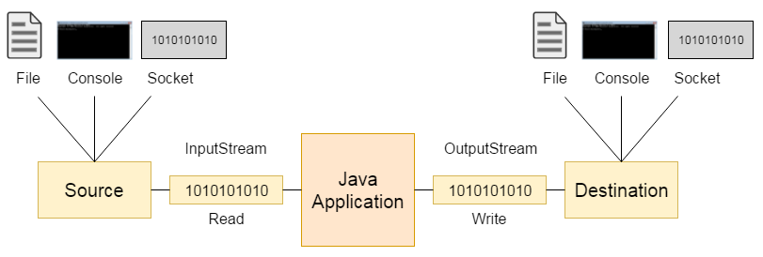

Slide 3
There are many classes and interfaces in the java.io package.

Slide 4
File
A File object is used to obtain or manipulate the information associated with a disk file.
Ex: permissions, time, date, and directory path etc.
File class does not specify how information is retrieved from or stored in files;
It describes the properties of a file itself.

Slide 5
File
A directory in Java is treated simply as a File with one additional property:
List of filenames that can be examined by the list( ) method.

Slide 6
Constructors used to create File objects:
File(String directoryPath)
File(String directoryPath, String filename)
File(File dirObj, String filename)
File(URI uriObj)

Slide 7
Constructors used to create File objects:
File f1 = new File(“c:/mit/ict/cce/prg1.txt");
File f2 = new File(" c:/mit/ict/cce/", “prg1.txt”);
File f3 = new File(" c:/mit/ict/cce/");
File f4 = new File(f3,”prg1.txt”);

Slide 8
Windows:
recognize forward slash(/).
If we use backaword slash, we need to use escape sequence(\\)
Unix :
recognize backword slash(\).

Slide 9
Methods :
String getName()
String getParent()
String getPath()
String getAbsolutePath()

Slide 10
Methods :
boolean exists()
boolean canWrite()
boolean canRead()
boolean isDirectory()
boolean isFile()
boolean isAbsolute()

Slide 11
Methods :
long lastModified()
long length()

Slide 12
Methods :
boolean renameTo(File newName)
newName becomes the new name of the invoking File object.
It will return true upon success and false if the file cannot be renamed.
(if you either attempt to rename a file so that it uses an existing filename).

Slide 13
Creating Directories
boolean mkdir( )
boolean mkdirs( )
mkdirs : To create a directory for which no path exists. It creates a directory and all the parents of the directory.

Slide 14
Creating Directories
File f = new File("D:\\MIT");
if (f.mkdir())
{
System.out.println("Directory is created");
}
else
{
System.out.println("Directory cannot be created");
}

Slide 15
Boolean delete()
To delete file and directory.
To delete directory, it should be empty

Slide 16
Directories
String [] list()

Slide 17
The listFiles( ) Alternative
Variation to the list( ) method.
Which returns File instead of string
File[ ] listFiles( )
File[ ] listFiles(FilenameFilter FFObj)

Slide 18
Using FilenameFilter
To limit the number of files returned by the list( ) method.
To include only those files that match a certain filename pattern, or filter.
Second form of list( ) :
String[ ] list(FilenameFilter FFObj)
FFObj is an object of a class that implements the FilenameFilter interface.

Slide 19
FilenameFilter defines a single method, accept( ), which is called once for each file in a list.
boolean accept(File directory, String filename)
The accept( ) method returns true for files in the directory specified by directory that should be included in the list (that is, those that match the filename argument), and returns false for those files that should be excluded.
The OnlyExt class implements FilenameFilter.

Slide 20
import java.io.*;
public class OnlyExt implements FilenameFilter
{
String ext;
public OnlyExt(String ext)
{
this.ext = "." + ext;
}
public boolean accept(File dir, String name)
{
return name.endsWith(ext);
}
}

Slide 21
import java.io.*;
class DirListOnly
{ public static void main(String args[])
{
String dirname = "/java";
File f1 = new File(dirname);
FilenameFilter only = new OnlyExt("html");
String s[] = f1.list(only);
for (int i=0; i < s.length; i++)
{ System.out.println(s[i]);
}
} }

Slide 22


A stream is a logical entity that either produces or consumes information.
A stream is linked to a physical device by the Java I/O system.

Slide 23
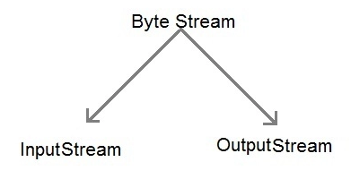
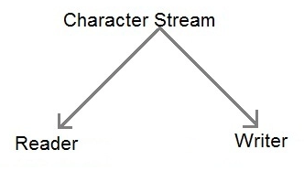

Slide 24
The Stream Classes
Java’s stream-based I/O is built upon four abstract classes:
InputStream,
OutputStream,
Reader,
Writer.
Used to create several concrete stream subclasses.
Programs perform their I/O operations through subclasses.
The top-level classes define the basic functionality common to all stream classes.

Slide 25
InputStream and OutputStream are designed for byte streams.
Reader and Writer are designed for character streams.
use the character stream classes when working with characters or strings, and use the byte stream classes when working with bytes or other binary objects.

Slide 26
The Byte Streams
Byte stream classes provide a rich environment for handling byte-oriented I/O.

Slide 27
InputStream
InputStream is an abstract class that defines Java’s model of streaming byte input.
Most of the methods in this class will throw an IOException on error conditions.

Slide 28
methods in InputStream.
int read( )
Returns an integer representation of the next available byte of input.

Slide 29
methods in InputStream.
int read( )
int read(byte buffer[ ])
Attempts to read up to buffer.length bytes into buffer and returns the actual number of bytes that were successfully read.

Slide 30
methods in InputStream.
int read( )
int read(byte buffer[ ])
int read(byte buffer[ ], int offset, int numBytes)
Attempts to read up to numBytes bytes into buffer starting at buffer[offset], returning the number of bytes successfully read.
–1 is returned when the end of the file is encountered.

Slide 31
methods in InputStream.
int available( )
Returns the number of bytes of input currently available for reading.

Slide 32
methods in InputStream.
int available( )
long skip(long numBytes)
Ignores (that is, skips) numBytes bytes of input, returning the number of bytes actually ignored.

Slide 33
methods in InputStream.
int available( )
long skip(long numBytes)
void close( )
Closes the input source. Further read attempts will generate an IOException.

Slide 34
methods in InputStream.
boolean markSupported( )
void mark(int numBytes)
void reset( )
Returns true if mark( )/reset( ) are supported by the invoking stream.
Places a mark at the current point in the input stream that will remain valid until numBytes bytes are read.
Resets the input pointer to the previously set mark.

Slide 35
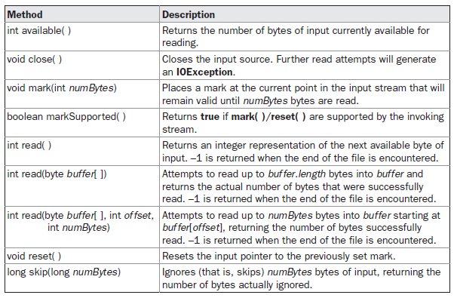
Table 19-1 shows the methods in InputStream.

Slide 36
OutputStream
OutputStream is an abstract class that defines streaming byte output.
Most of the methods in this class return void and throw an IOException in the case of errors.

Slide 37
methods in OutputStream.
void write(int b)
void write(byte buffer[ ])
void write(byte buffer[ ], int offset, int numBytes)
Writes a subrange of numBytes bytes from the array buffer, beginning at buffer[offset].

Slide 38
methods in OutputStream.
void close( )
void flush( )
Closes the output stream. Further write attempts will generate an IOException.
Finalizes the output state so that any buffers are cleared.

Slide 39
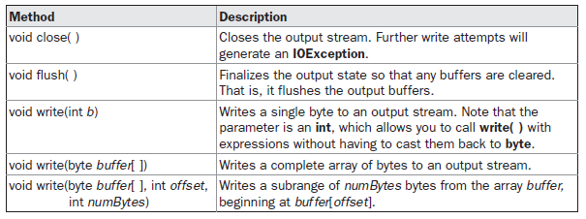
Table 19-2 shows the methods in OutputStream.

Slide 40
FileInputStream
The FileInputStream class creates an InputStream that we can use to read bytes from a file.
FileInputStream(String filepath)
FileInputStream(File fileObj)
Either can throw a FileNotFoundException.
FileInputStream

Slide 41
Example
FileInputStream f0 = new FileInputStream (“c:/mit/ict/cce/prg1.txt");
File f = new File (“c:/mit/ict/cce/prg1.txt");
FileInputStream f1 = new FileInputStream(f);
FileInputStream

Slide 42
FileOutputStream
FileOutputStream creates an OutputStream that you can use to write bytes to a file.
FileInputStream
FileOutputStream

Slide 43
FileOutputStream
FileOutputStream(String filePath)
FileOutputStream(File fileObj)
FileOutputStream(String filePath, boolean append)
FileOutputStream(File fileObj, boolean append)
They can throw a FileNotFoundException.
If append is true, the file is opened in append mode.
Creation of a FileOutputStream is not dependent on the file already existing.
FileOutputStream will create the file before opening it for output when we create the object.
In the case where you attempt to open a read-only file, an IOException will be thrown.

Slide 44
// Demonstrate FileOutputStream.
import java.io.*;
class FileOutputStreamDemo
{ public static void main(String args[]) throws IOException
{
String source = "Now is the time for all good men\n"
+ " to come to the aid of their country\n"
+ " and pay their due taxes.";
byte buf[] = source.getBytes();
OutputStream f0 = new FileOutputStream("file1.txt");
for (int i=0; i < buf.length; i += 2)
{ f0.write(buf[i]);
}
f0.close();

Slide 45
OutputStream f1 = new FileOutputStream("file2.txt");
f1.write(buf);
f1.close();
OutputStream f2 = new FileOutputStream("file3.txt");
f2.write(buf,buf.length-buf.length/4,buf.length/4);
f2.close();
}
}

Slide 46
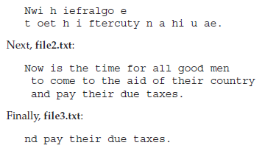
The first, file1.txt, will contain every other byte from the sample.
The second, file2.txt, will contain the entire set of bytes.
The third and last, file3.txt, will contain only the last quarter.
String source = "Now is the time for all good men\n"
+ " to come to the aid of their country\n"
+ " and pay their due taxes.";

Slide 47
The Character Streams
Top of the character stream hierarchies are the Reader and Writer abstract classes.

Slide 48
The Character Streams
The byte stream classes provide functionality to handle any type of I/O operation, they cannot work directly with Unicode characters.
Character streams : direct I/O support for characters.
NOTE :
The character I/O classes were added by the 1.1 release of Java.
Because of this, we may still find legacy code that uses byte streams where character streams would be more appropriate

Slide 49
Reader
Reader is an abstract class that defines Java’s model of streaming character input.

Slide 50
Reader methods
int read( )
int read(char buffer[ ])
int read(char buffer[ ], int offset, int numChars)
Returns an integer representation of the next available character from the invoking input stream.
Attempts to read up to buffer.length characters into buffer and returns the actual number of characters that were successfully read.
Attempts to read up to numChars characters into buffer starting at buffer[offset], returning the number of characters successfully read.
–1 is returned when the end of the file is encountered.

Slide 51
Reader methods
long skip(long numBytes)
void close( )
Skips over numChars characters of input, returning the number of characters actually skipped.
Closes the input source. Further read attempts will generate an IOException.

Slide 52
Reader methods
boolean markSupported( )
void mark(int numChars)
void reset( )
Returns true if mark( )/reset( ) are supported on this stream.
Places a mark at the current point in the input stream that will remain valid until numChars characters are read.
Resets the input pointer to the previously set mark.

Slide 53
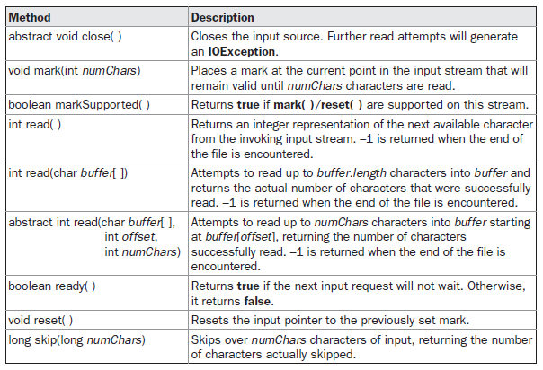
Table 19-3 provides a synopsis of the methods in Reader.

Slide 54
Writer
Writer is an abstract class that defines streaming character output.
All of the methods in this class throw an IOException in the case of errors.

Slide 55
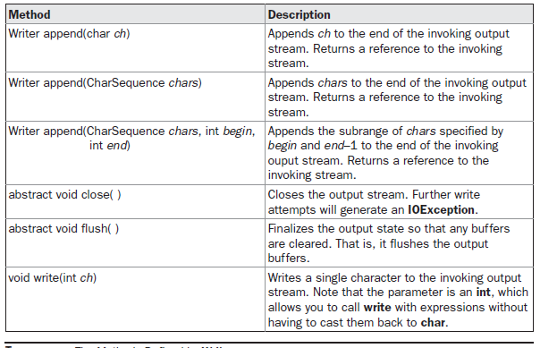
Table 19-4 shows a synopsis of the methods in Writer.

Slide 56
……….
……….
FileReader
FileWriter

Slide 57
FileReader
FileReader class creates a Reader that can be uses to read the contents of a file.
Its two most commonly used constructors are:
FileReader(String filePath)
FileReader(File fileObj)
Either can throw a FileNotFoundException. Here, filePath is the full path name of a file, and fileObj is a File object that describes the file.

Slide 58
// Demonstrate FileReader.
import java.io.*;
class FileReaderDemo
{ public static void main(String args[]) throws IOException
{
FileReader fr = new FileReader("FileReaderDemo.java");
int i;
while((i = fr.read()) != -1)
{ System.out.println((char)i);
}
fr.close();
}}

Slide 59
FileWriter
FileWriter creates a Writer that we can use to write to a file.
Its most commonly used constructors are:
FileWriter(String filePath)
FileWriter(String filePath, boolean append)
FileWriter(File fileObj)
FileWriter(File fileObj, boolean append)
They can throw an IOException.
If append is true, then output is appended to the end of the file.
Creation of a FileWriter is not dependent on the file already existing. FileWriter will create the file before opening it for output when you create the object. In the case where you attempt to open a read-only file, an IOException will be thrown.

Slide 60
// Demonstrate FileWriter.
import java.io.*;
class FileWriterDemo
{ public static void main(String args[]) throws IOException
{
String source = "Now is the time for all good men\n"
+ " to come to the aid of their country\n"
+ " and pay their due taxes.";
char buffer[] = new char[source.length()];
source.getChars(0, source.length(), buffer, 0);
FileWriter f0 = new FileWriter("file1.txt");
for (int i=0; i < buffer.length; i += 2) {
f0.write(buffer[i]);
}
f0.close();

Slide 61
FileWriter f1 = new FileWriter("file2.txt");
f1.write(buffer);
f1.close();
FileWriter f2 = new FileWriter("file3.txt");
f2.write(buffer,buffer.length-buffer.length/4,buffer.length/4);
f2.close();
}
}
The first, file1.txt, will contain every other character from the sample.
The second, file2.txt, will contain the entire set of characters.
Finally, the third, file3.txt, will contain only the last quarter

Slide 62
BufferedReader and BufferedWriter
The advantage of buffering is that the number of reads and writes to a physical device is reduced.
This improves the performance.
BufferedReader class extends Reader and buffers input from a character stream.
BufferedReader(Reader r)
BufferedReader(Reader r, bufSize)
The first form creates a buffered stream using a buffer with a default size.
In the second, size of the buffere is specified with bufSize.

Slide 63
BufferedReader and BufferedWriter
This class implements all of the methods defined by Reader.
In addition, provides the readLine() method reads newline terminated strings from a character stream.
String readLine() throws IOException

Slide 64
import java.io.*;
class BufferedReaderDemo1
{ public static void main(String args[]) throws IOException
{
FileReader fr = new FileReader("D:\\IOExamples\\MIT\\ICT\\first.txt");
BufferedReader br = new BufferedReader(fr);
String s;
while((s = br.readLine()) != null)
{
System.out.println(s);
}
fr.close();
}
}

Slide 65
BufferedReader and BufferedWriter
The BufferedWriter class extends Writer and buffers output to a character stream.
BufferedWriter(Writer w)
BufferedWriter(Writer w, bufSize)
The first form creates a buffered stream using a buffer with a default size.
In the second, size of the buffere is specified with bufSize.

Slide 66
BufferedWriter and BufferedReader
BufferedWriter class implements all of the methods defined by Writer.
In addition, provides the newline() method to output a line separator.
void newLine() throws IOException

Slide 67
import java.io.*;
class BufferedWriterDemo1
{ public static void main(String args[]) throws IOException
{
FileWriter fw = new FileWriter(“D:\\IOExamples\\MIT\\ICT\\first.txt");
BufferedWriter bw = new BufferedWriter(fw);
for(int i=0;i<12;i++)
bw.write("Line "+i+"\n");
bw.close();
}
}

Slide 68
Tutorial class
Write a java program to find the occurrence of word in a given file

Slide 69
Consider a directory MIT/ICT which contains java files, out of which one file is the replica of another file. Write a java program to find those 2 files.

Slide 70
Write a java program to remove the comments from file.

Slide 71
Consider a file student.txt which contains flowing information.
regno : name : mark
Where the fields are separated by :
Write a java program to display the student who scored highest mark.

Slide 72
Write a java program to write all palindrome into a new file.

Slide 73
Serialization
The process of writing the state of an object to a byte stream.
To save the state of our program to a persistent storage area, such as a file.
At a later time, we may restore these objects by using the process of deserialization.
Serialization is also needed to implement Remote Method Invocation (RMI).
An object may be supplied as an argument to that remote method. The sending machine serializes the object and transmits it. The receiving machine deserializes it.

Slide 74
Serializable
Only an object that implements the Serializable interface can be saved and restored by the serialization facilities.
The Serializable interface defines no members.
  It is simply used to indicate that a class may be serialized.
  If a class is serializable, all of its subclasses are also serializable.
static variables are not saved.

Slide 75
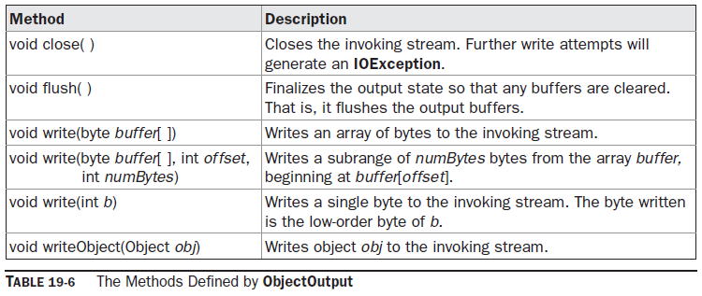
ObjectOutput
The ObjectOutput interface extends the DataOutput interface and supports object serialization. Follwing are the methods.
The writeObject( ) method is called to serialize an object.
All of these methods will throw an IOException on error conditions.

Slide 76
ObjectOutputStream
The ObjectOutputStream class extends the OutputStream class and implements the ObjectOutput interface.
It is responsible for writing objects to a stream.
ObjectOutputStream(OutputStream outStream) throws IOException
outStream is the output stream to which serialized objects will be written.
Several commonly used methods in this class are shown in Table 19-7.
They will throw an IOException on error conditions.

Slide 77
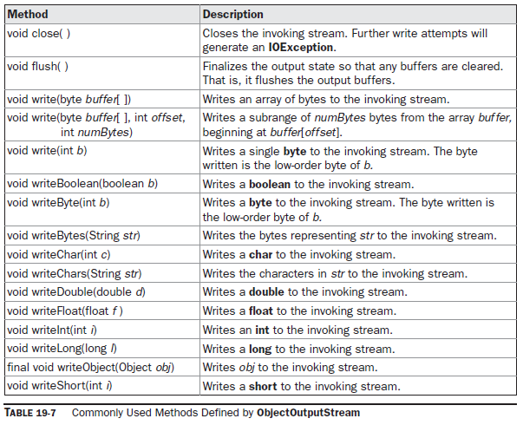

Slide 78
ObjectInput
The ObjectInput interface extends the DataInput interface and defines the methods shown in Table 19-8.
It supports object serialization.
The readObject( ) method is called to deserialize an object.
All of these methods will throw an IOException on error conditions.
The readObject( ) method can also throw ClassNotFoundException.

Slide 79
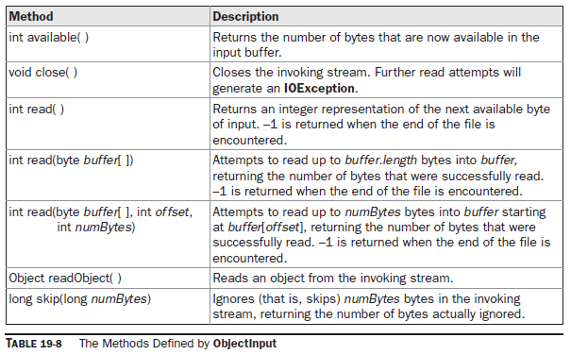

Slide 80
ObjectInputStream
The ObjectInputStream class extends the InputStream class and implements the ObjectInput interface.
ObjectInputStream is responsible for reading objects from a stream.
ObjectInputStream(InputStream inStream) throws IOException
inStream is the input stream from which serialized objects should be read.
Several commonly used methods in this class are shown in Table 19-9.
They will throw an IOException on error conditions. The readObject( ) method can also throw ClassNotFoundException.

Slide 81
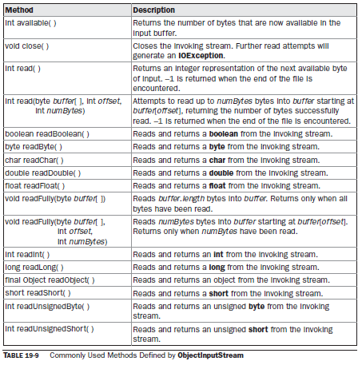

Slide 82
DataOutput
OutputStream
ObjectOutput
ObjectOutputStream
DataOutputStream

Slide 83
DataInput
InputStream
ObjectIntput
ObjectInputStream
DataInputStream

Slide 84
class MyClass implements Serializable
{
String s;
int i;
double d;
public MyClass(String s, int i, double d)
{ this.s = s;
this.i = i;
this.d = d;
}
public String toString()
{ return "s=" + s + "; i=" + i + "; d=" + d;
}
}

Slide 85
public class SerializationDemo
{ public static void main(String args[])
{ // Object serialization
try
{
MyClass object1 = new MyClass("Hello", -7, 2.7e10);
System.out.println("object1: " + object1);
FileOutputStream fos = new FileOutputStream("serial");
ObjectOutputStream oos = new ObjectOutputStream(fos);
oos.writeObject(object1);
oos.flush();
oos.close();
}
catch(IOException e)
{ System.out.println("Exception during serialization: " + e);
System.exit(0); }

Slide 86
// Object deserialization
try
{
MyClass object2;
FileInputStream fis = new FileInputStream("serial");
ObjectInputStream ois = new ObjectInputStream(fis);
object2 = (MyClass)ois.readObject();
ois.close();
System.out.println("object2: " + object2);
}
catch(Exception e) { System.out.println("Exception during deserialization: " + e);
System.exit(0); }
}
}

Slide 87
Create a class student with name and sessional mark as its data members, use constructor to initialize the object and a method to display the student details.
Write a program to write 5 student objects into a “student.txt” file.
Also read the contents of the file and display only those students detail whose sessional marks are above 10.

Slide 88
Write a java program to insert following details into the student.txt.
Anil 12 13
Sunil 8 9
Rahul 13 11
Write a java program to read the students detail from student.txt file and display only those students details whose total mark is more than 20;

Slide 89
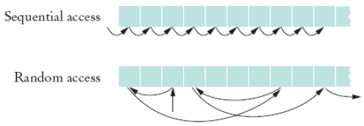
RandomAccessFile
Random access files are files in which records can be accessed in any order

Slide 90
RandomAccessFile
RandomAccessFile class to allow a file to be read from and write to at random locations.
RandomAccessFile is special because it supports positioning requests: we can position the file pointer within the file.
It is not derived from InputStream or OutputStream.
It implements the interfaces DataInput and DataOutput, which define the basic I/O methods.

Slide 91
RandomAccessFile(File fileObj, String access) throws FileNotFoundException
RandomAccessFile(String filename, String access) throws
FileNotFoundException
access determines what type of file access is permitted.
If it is “r”, then the file can be read, but not written.
If it is “rw”, then the file is opened in read-write mode.

Slide 92
seek( ) : to set the current position of the file pointer within the file:
void seek(long newPos) throws IOException
newPos specifies the new position (in bytes), of the file pointer from the beginning of the file.
After a call to seek( ), the next read or write operation will occur at the new file position.

Slide 93
long getFilePointer() throws IOException
Returns the current offset, in bytes, from the beginning of the file to where the next read or write occurs.

Slide 94
int skipBytes(int n)
Add n to the file pointer. Returns actual number of bytes skipped. If n s negative, no bytes are skipped.

Slide 95
void setLength(long len) throws IOException
This method sets the length of the invoking file to that specified by len.
This method can be used to lengthen or shorten a file.
If the file is lengthened, the added portion is undefined.

Slide 96
long length()
returns the length of the file in bytes.

Slide 97
int read();
int read(byte buffer[]);
int read(byte buffer[], int index, int size);

Slide 98
void write(int b);
void write(byte buffer[]);
void write(byte buffer[], int index, int size);

Slide 99


